Slide 1
Introduction to Programming
Linked Lists

Slide 2
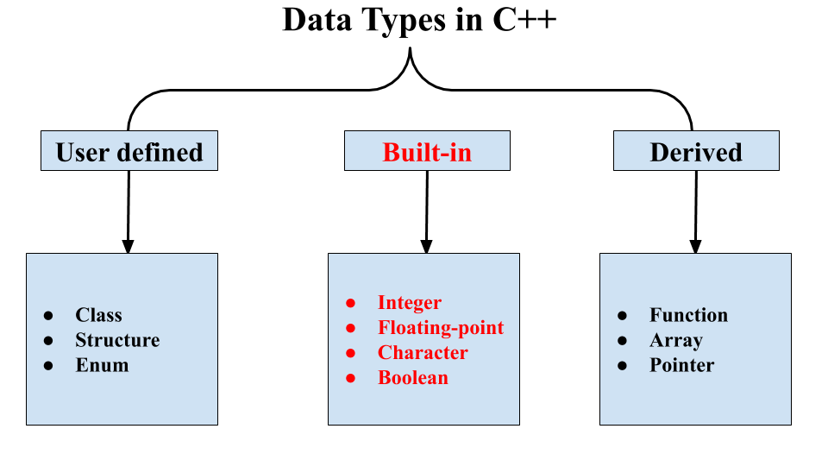
Data types and data structures
Data types
Set of values.
Set of operations on those values.
Some are built into C++: int, double, …
Some in standard library: string, …
Most are not: user-defined types
Data structures
Represent data.
Represent relationships among data.
Some are built into C++: 1D arrays, 2D arrays, …
Most are not: linked-lists, trees, graphs

Slide 3
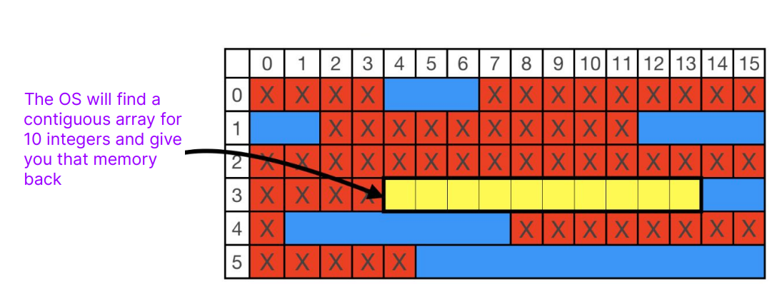
Problem with the arrays
int* tenInts = new int[10];

Slide 4
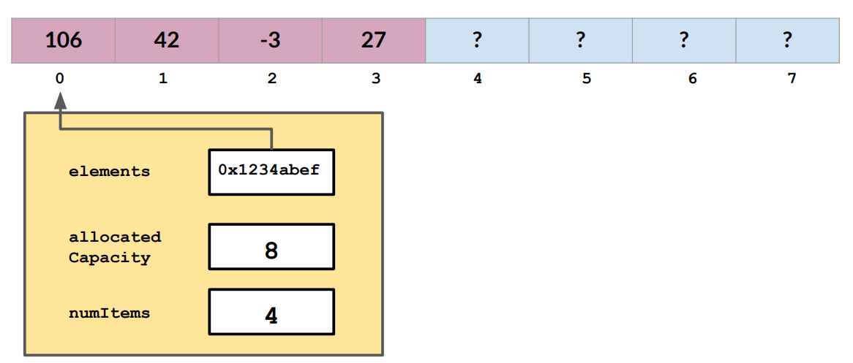
Remove Operation
We intend to remove the first index from the array. How can we do that?

Slide 5
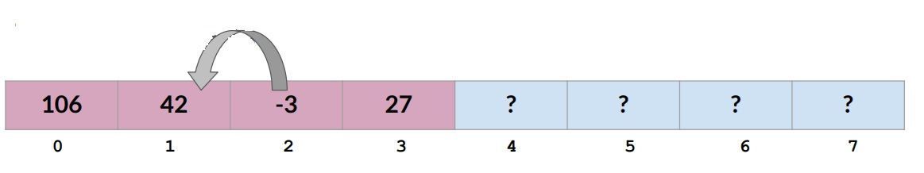
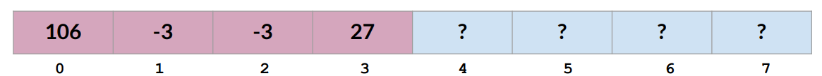
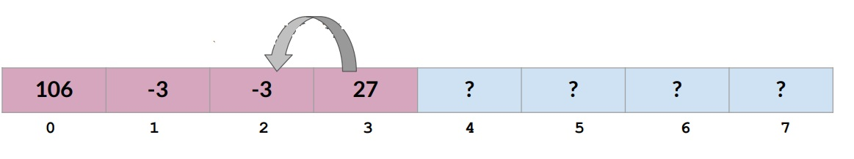
Remove Operation

Slide 6
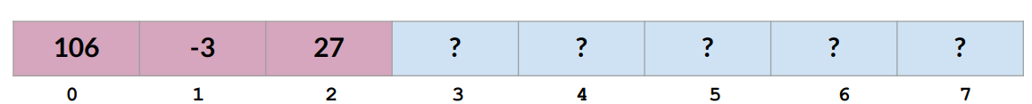
Remove Operation

Slide 7
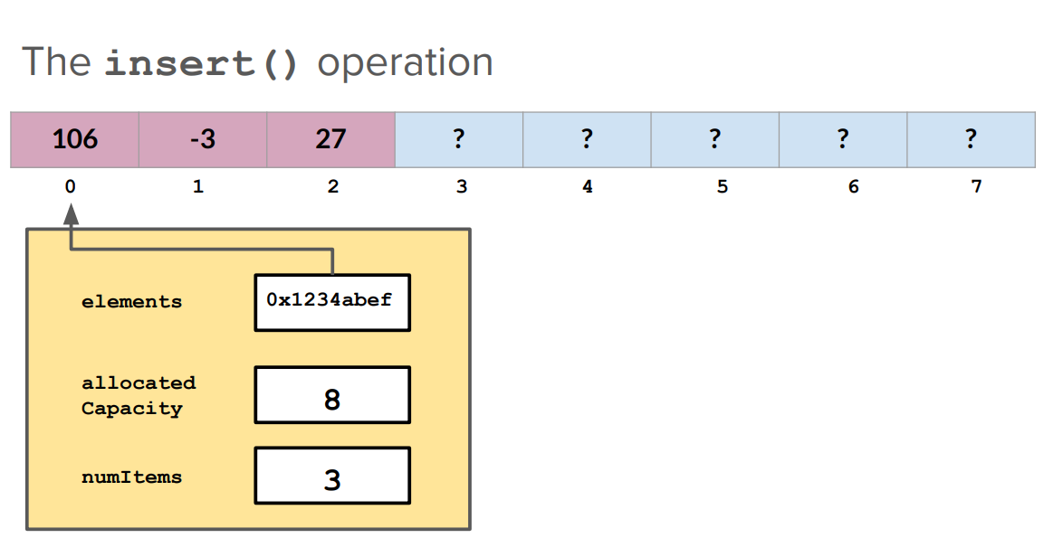
Insert Operation
We intend to insert an element at 0 index.

Slide 8
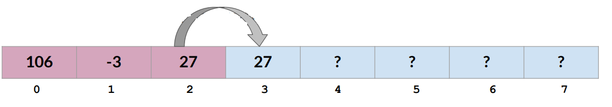
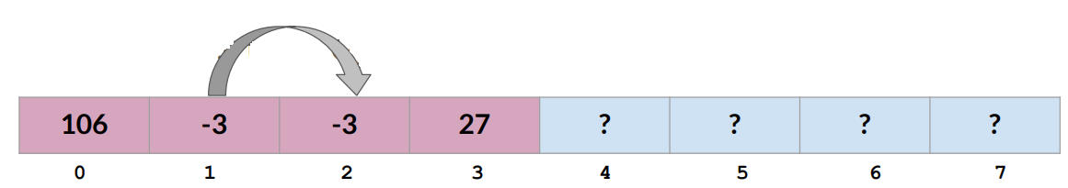
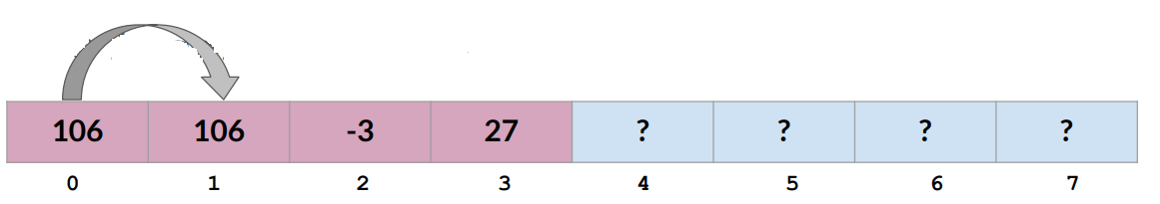
Insert Operation

Slide 9
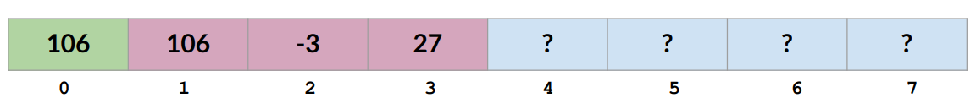
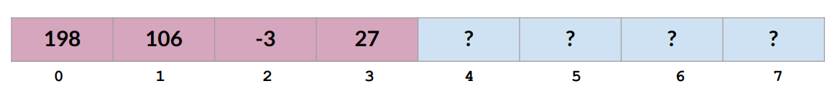
Insert Operation

Slide 10
Can we do better?
A way to store elements as a sequence even if they’re not physically next to each other on the computer memory
So, we can easily insert new elements into the list
So, we can easily remove elements from the list
So, we can easily resize the list (So we don’t have to mass copy elements and shift them over or shift them into a new block of memory)

Slide 11
Data structures: sequential vs. linked
Sequential data structure
Put objects next to one another.
Machine: consecutive memory cells.
C++: array of objects.
Fixed size, arbitrary access.
Linked data structure
Associate with each object a link to another one.
Machine: link is memory address of next object.
C++: link is pointer to next object.
Variable size, sequential access.
Overlooked by novice programmers.
Flexible, widely used method for organizing data.

Slide 12
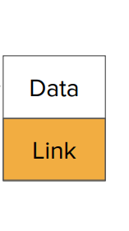
What is linked list?
A linked list is a chain of nodes.
Each node contains two pieces of information:
Some piece of data that is stored in the sequence
A link to the next node in the list
struct node {
string item;
node* next;
};

Slide 13
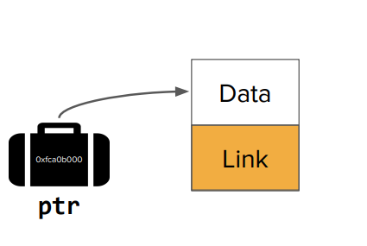
Pointer to node

Slide 14
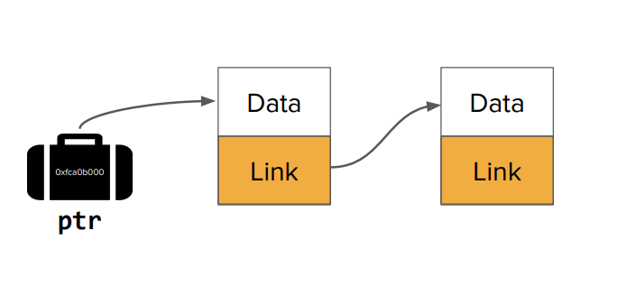
Pointer to a node that points to a node

Slide 15
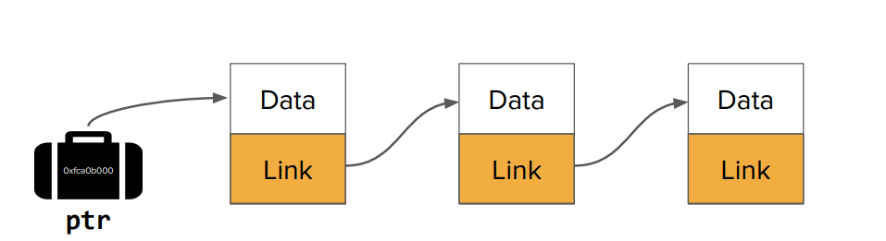
Pointer to a node that points to a node that points to a node

Slide 16
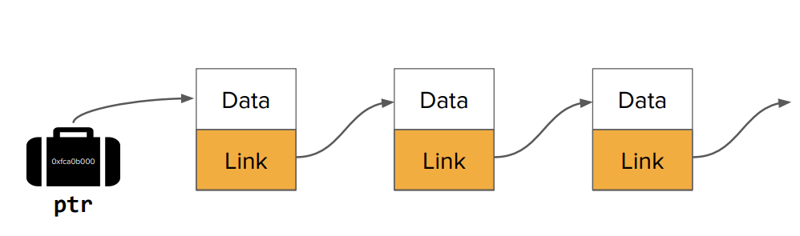
Pointer to a node that points to a node that points to a node
Null Pointer

Slide 17
Why use linked list?
More flexible than arrays!
Since they’re not contiguous, they’re easier to rearrange.
We can efficiently slice new elements into the list or remove existing elements anywhere in the list. (We’ll see how shortly!)
We never have to do a massive copy step.
But linked lists still have many tradeoffs and are not always the best data structure!

Slide 18
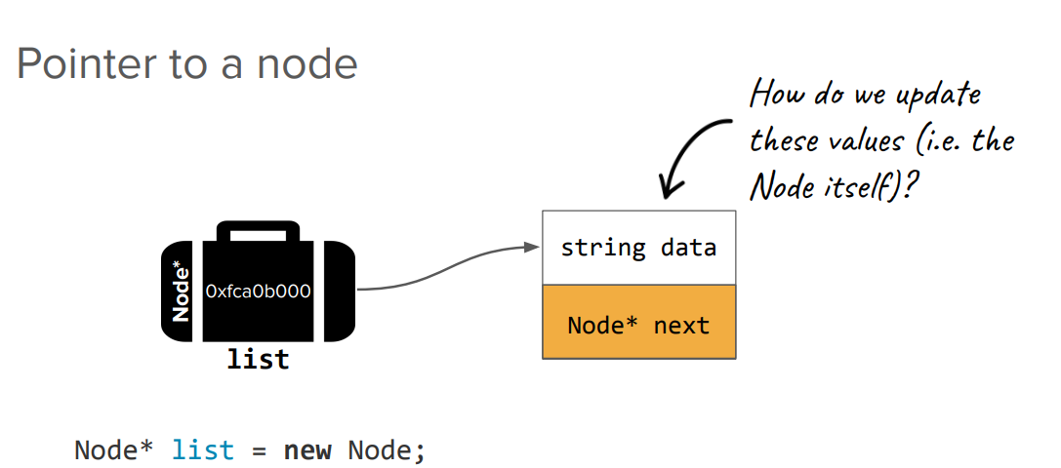
Pointer to Node

Slide 19
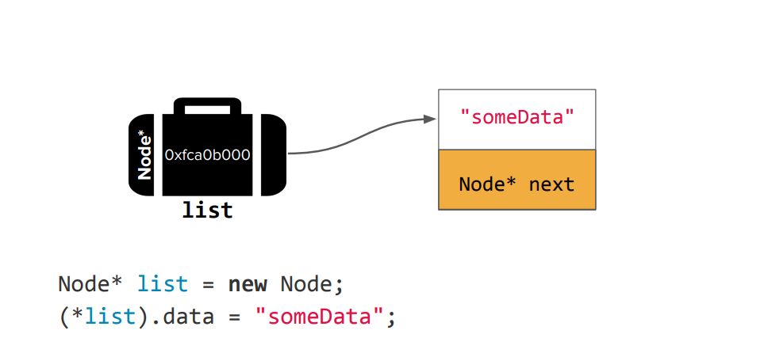
Pointer to Node

Slide 20
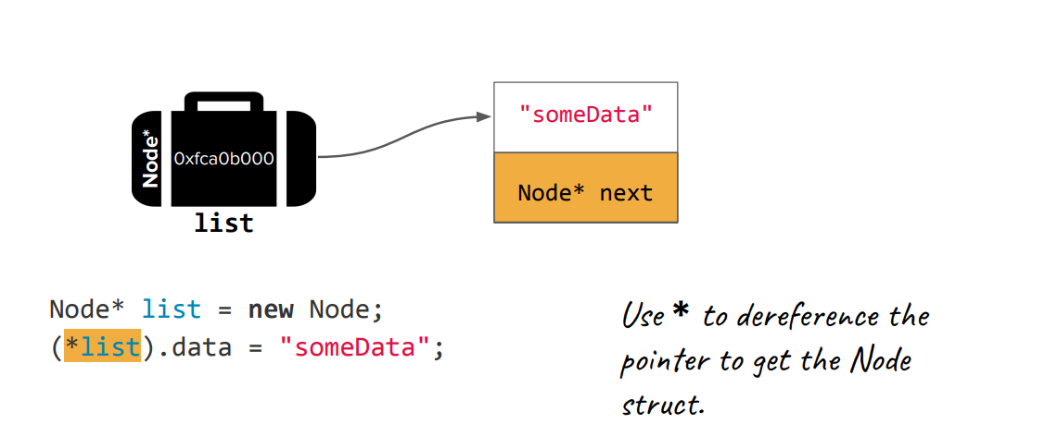
Pointer to Node

Slide 21
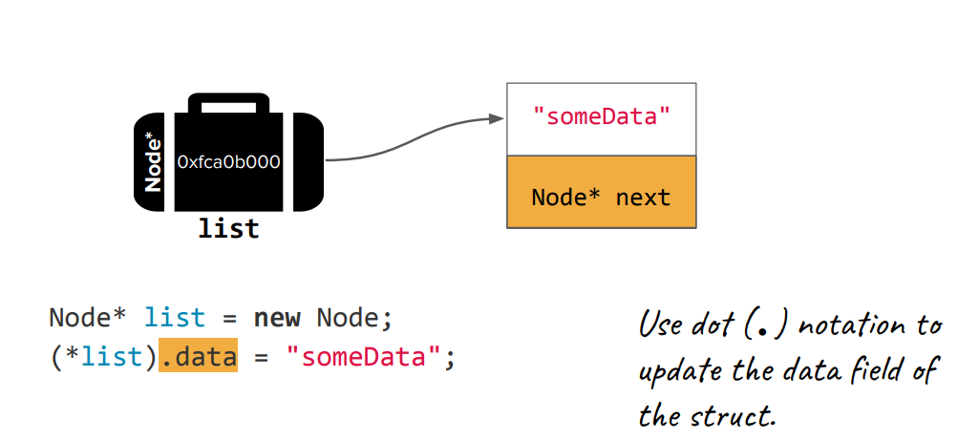
Pointer to Node

Slide 22
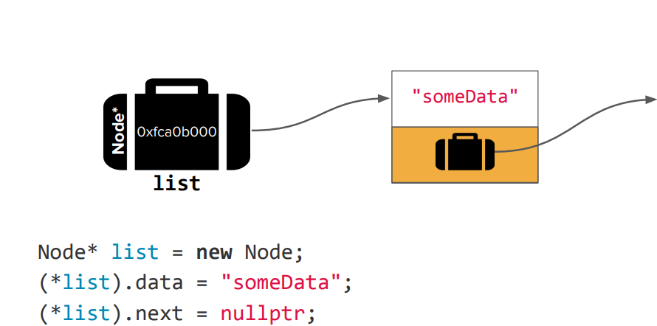
Pointer to Node
Null Pointer
There is an easier way. What?

Slide 23
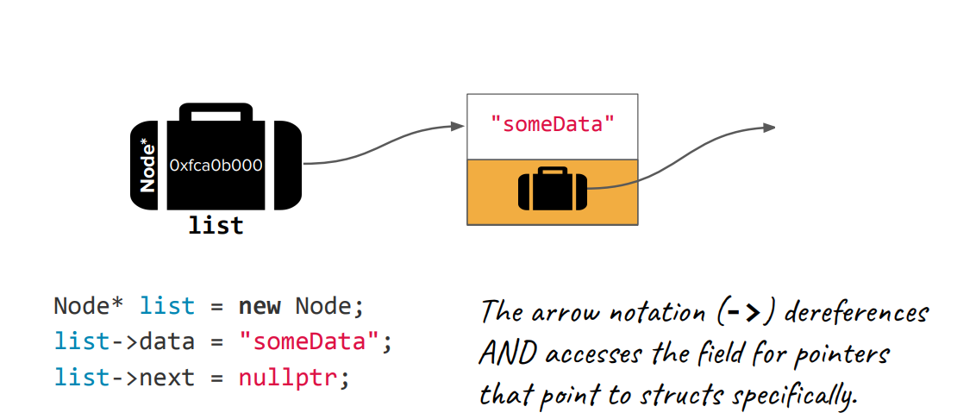
Pointer to Node
Null Pointer

Slide 24
Implementing Stack using Linked List
Note: You could do this with an array! This is just for the sake of getting practice with linked lists.

Slide 25
Stack as Linked List
We’ll keep a pointer Node* top that points to the “top” element in our stack.
This member var will get initialized to nullptr when our stack is empty!
Our linked list nodes will be connected from the top to the bottom of our stack.
Our stack will specifically hold integers, so our Node struct will hold an int type for our data field:
struct Node {
int data;
Node* next; }

Slide 26
Three Operation
Push
Pop
Destructor

Slide 27
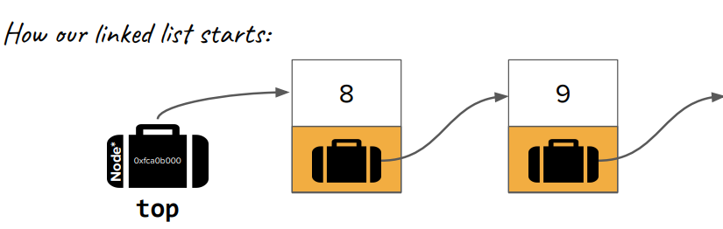
Push
Suppose we have the following Stack we want to push to:
Stack myStack = {9, 8}; // 8 is at the "top" of the stack
myStack.push(7); // we want the result to be {9, 8, 7}
Null Pointer

Slide 28
Lets Code Push

Slide 29
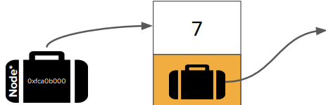
New Node
Node *temp = new Node;
temp->data = 7;
Temp

Slide 30
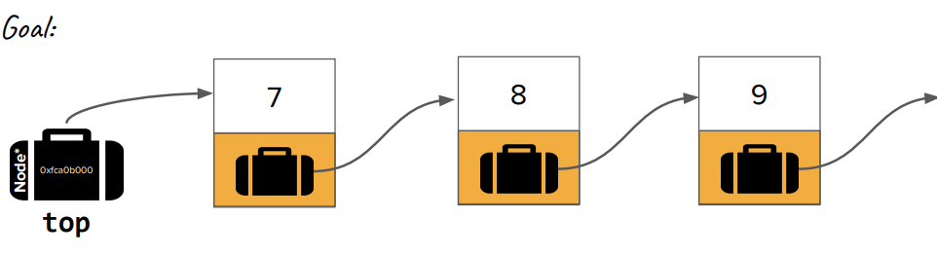
Push
Node *temp = new Node;
temp->data = 7;
temp->next = top;
top = temp;
Null Pointer

Slide 31
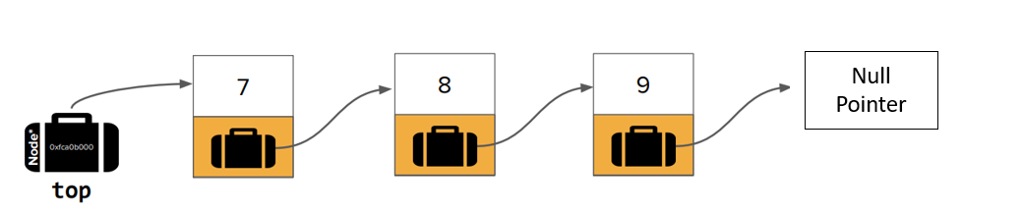
Pop
Now we want to remove the top value: ...
myStack.pop(); // we want the result to be {9, 8}

Slide 32
Lets Code Pop

Slide 33
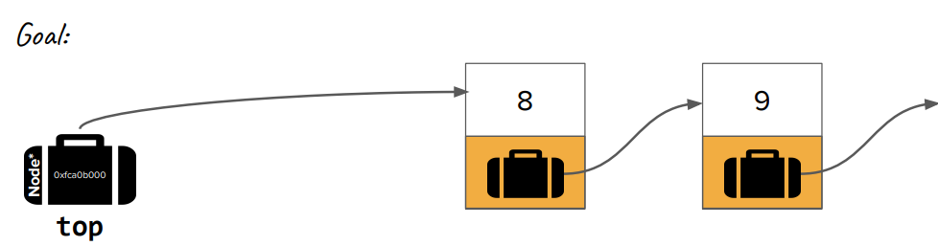
Pop
Node* temp = top;
top = top->next;
delete temp;
Null Pointer

Slide 34
Destructor
We have to make sure we delete all of the Nodes.
The top pointer should be nullptr when we’re done.

Slide 35
Lets Code Destructor

Slide 36
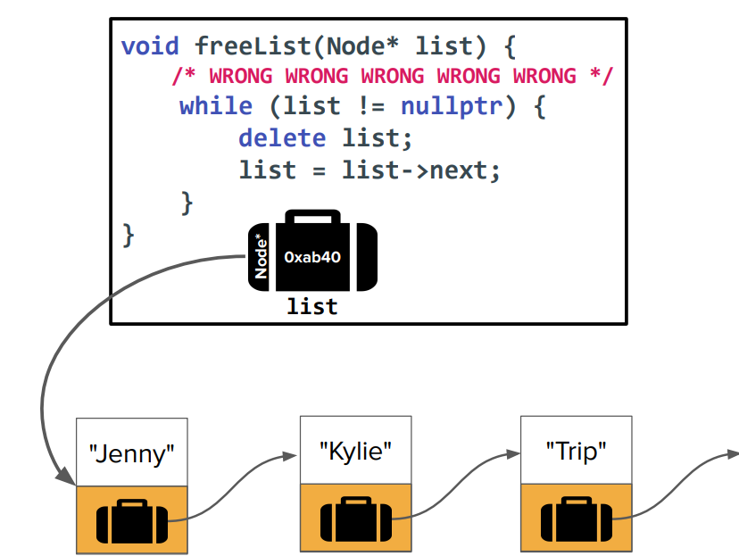
What is wrong with the code?
Null Pointer

Slide 37
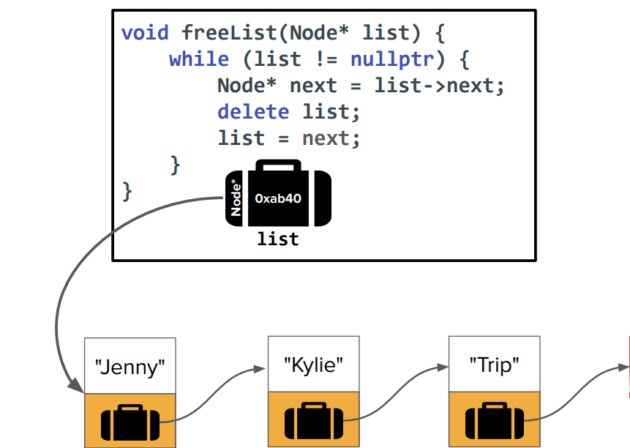
Freeing Memory the Correct Way
Null Pointer

Slide 38
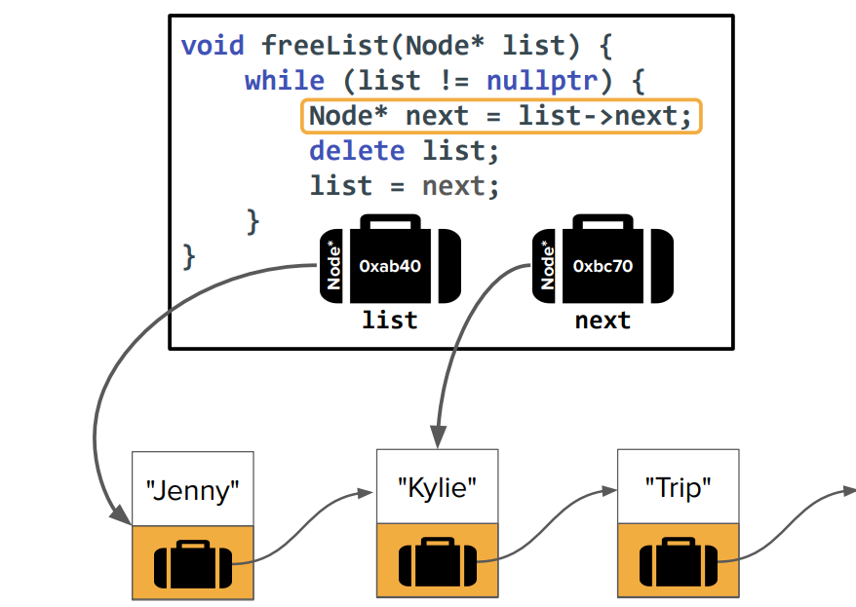
Null Pointer

Slide 39
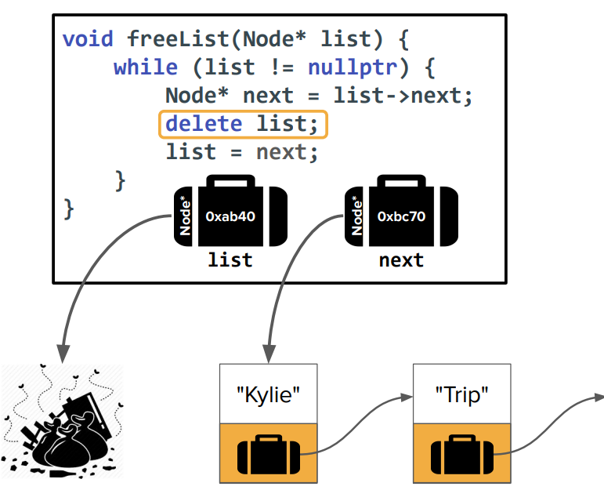
Null Pointer

Slide 40
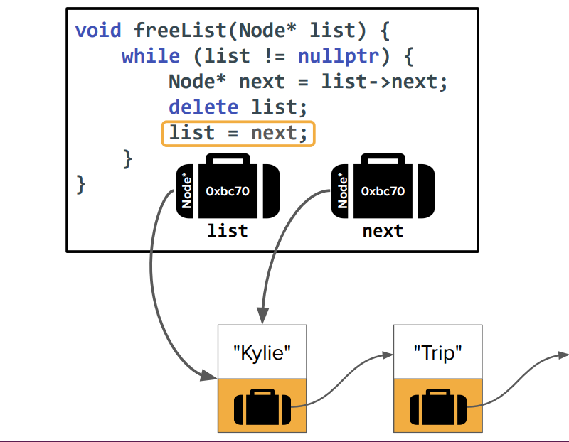
Null Pointer

Slide 41
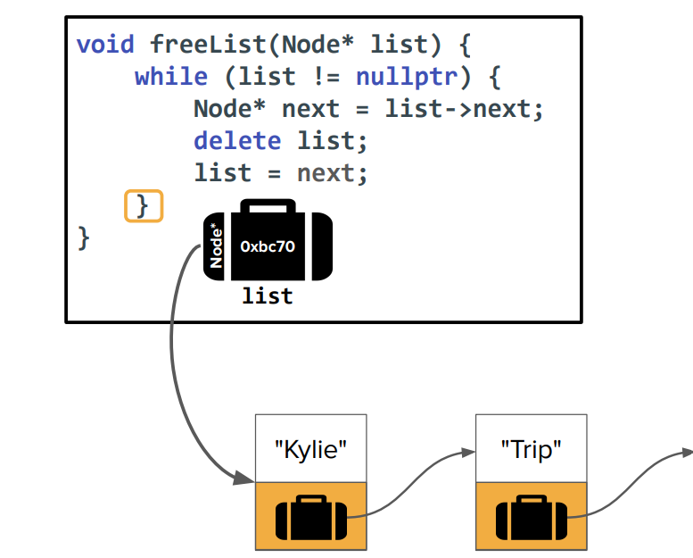
Null Pointer

Slide 42
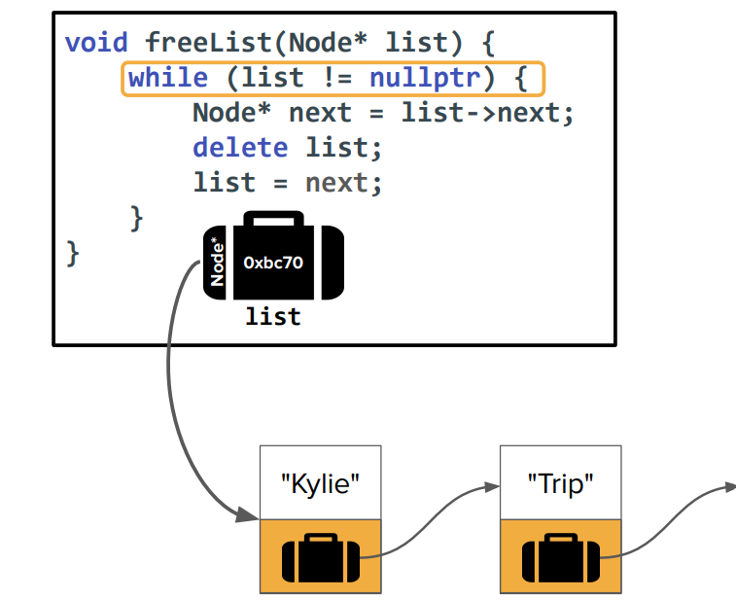
Null Pointer

Slide 43
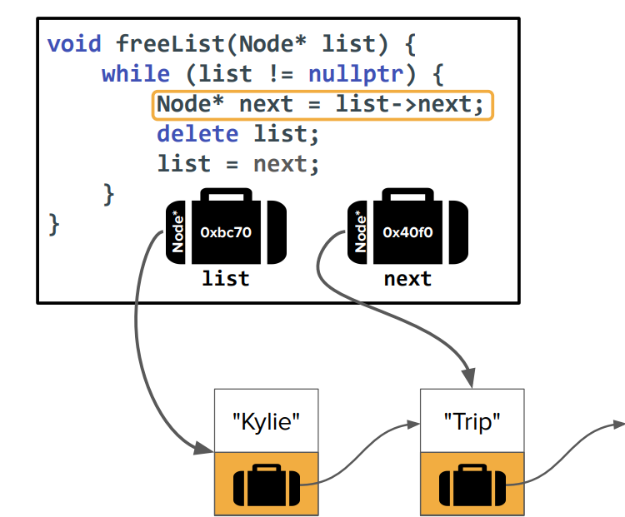
Null Pointer

Slide 44
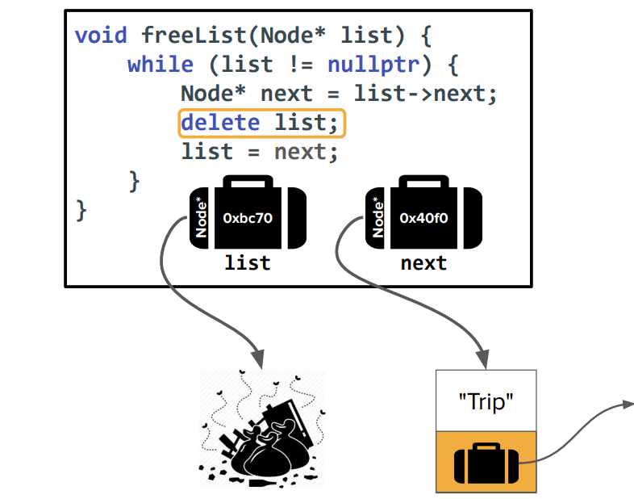
Null Pointer

Slide 45
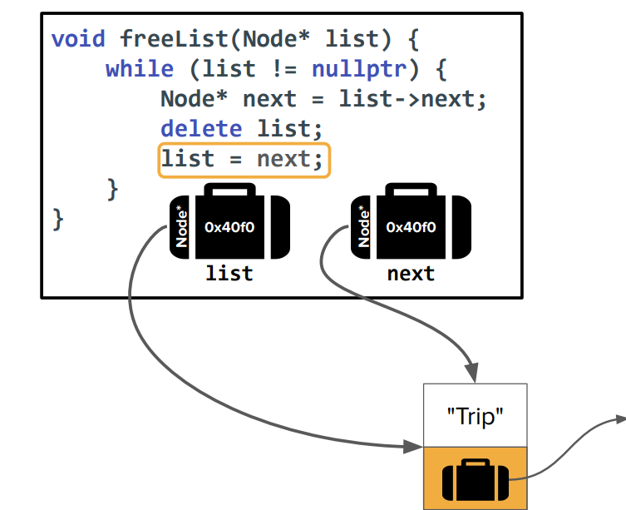
Null Pointer

Slide 46
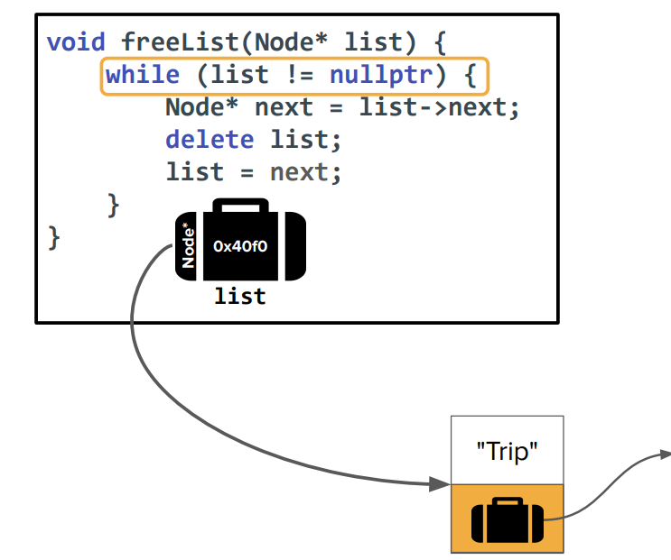
Null Pointer

Slide 47
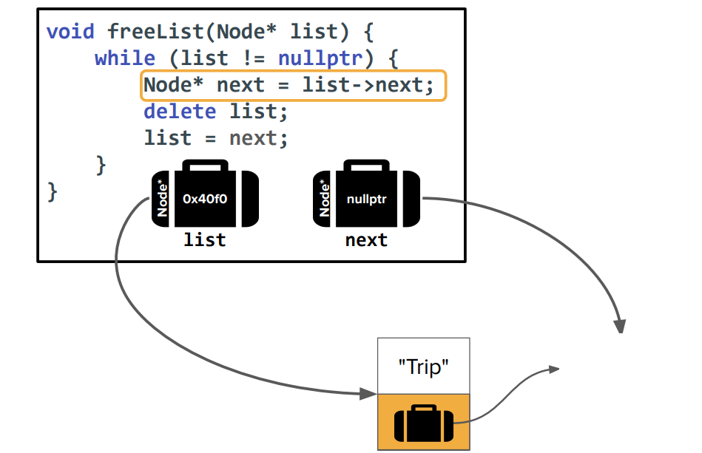
Null Pointer

Slide 48
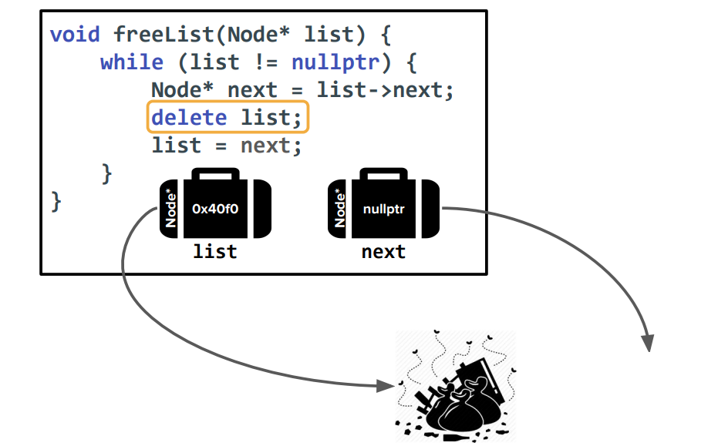
Null Pointer

Slide 49
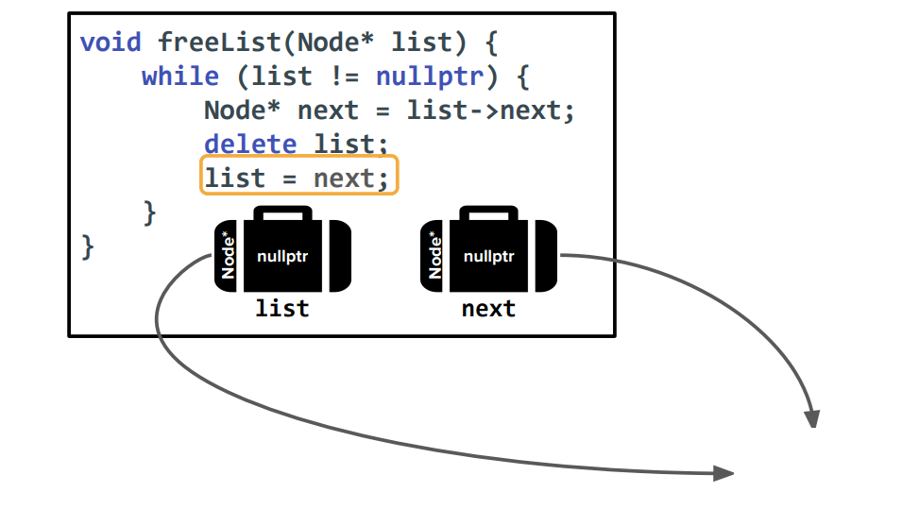
Null Pointer

Slide 50
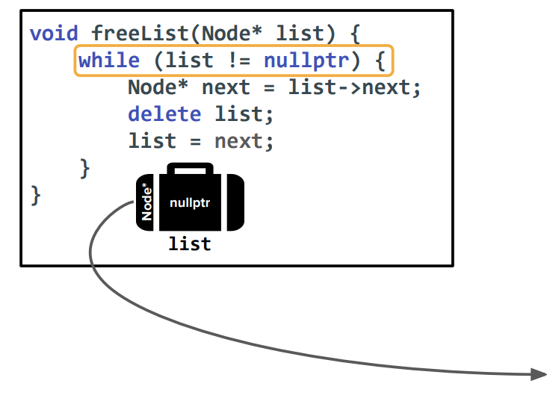
Null Pointer

Slide 51
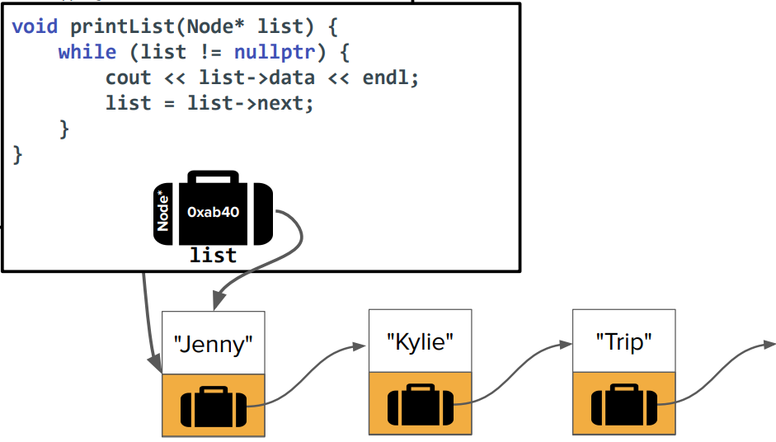
Printing List Function
Null Pointer

